Slide 1


Trade flow, Nature of Transactions
Habib Khan (khan39@un.org)
United Nations Statistics Division
Notes:
1

Slide 2
Customs Procedure Codes (CPC)
Used by Customs to describe flow of trade and nature of transaction
It is used also to categorize special transaction on specific goods, trading partners, etc.
It is mostly driven by the need to manage application customs duties
  i.e., inward processing procedure relives partly of fully customs duties
Notes:
It’s quite simple, but this is the main quality issues that many trade compilers face. Therefore, it is necessary to define “Statistical Territory”

Slide 3
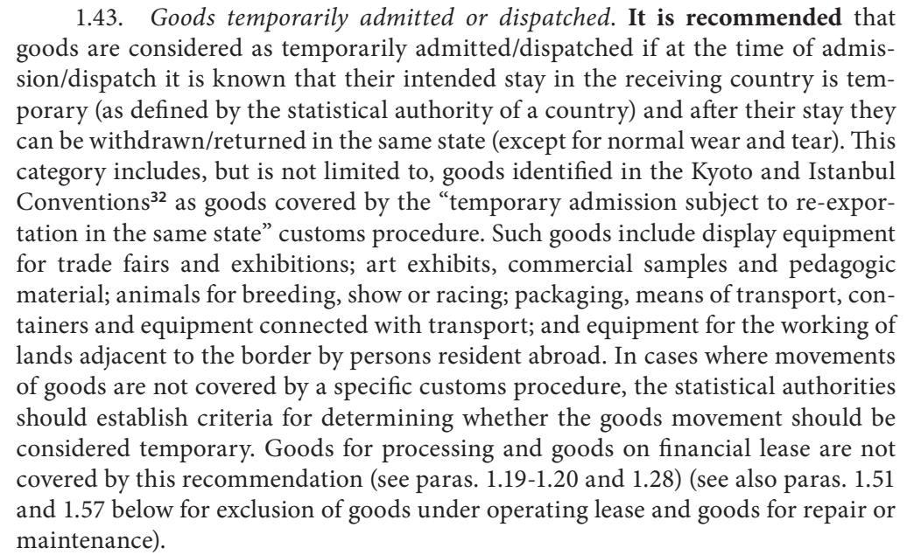
Temporary movement
is to be excluded …, but some cases can be complex
  Customs warehouse as storage?
  Leasing?
  Commercial samples?
  Goods for processing?
  Goods for repair/maintenance?
as defined by statistical authorities
of a country
Notes:
HOWEVER, some movements are considered temporary therefore not considered as “add to or subtract from”
1.43. Goods temporarily admitted or dispatched. It is recommended that
goods are considered as temporarily admitted/dispatched if at the time of admission/
dispatch it is known that their intended stay in the receiving country is temporary
(as defined by the statistical authority of a country) and after their stay they
can be withdrawn/returned in the same state (except for normal wear and tear). This
category includes, but is not limited to, goods identified in the Kyoto and Istanbul
Conventions32 as goods covered by the “temporary admission subject to re-exportation
in the same state” customs procedure. Such goods include display equipment
for trade fairs and exhibitions; art exhibits, commercial samples and pedagogic
material; animals for breeding, show or racing; packaging, means of transport, containers
and equipment connected with transport; and equipment for the working of
lands adjacent to the border by persons resident abroad. In cases where movements
of goods are not covered by a specific customs procedure, the statistical authorities
should establish criteria for determining whether the goods movement should be
considered temporary. Goods for processing and goods on financial lease are not
covered by this recommendation (see paras. 1.19-1.20 and 1.28) (see also paras. 1.51
and 1.57 below for exclusion of goods under operating lease and goods for repair or
maintenance).

Slide 4
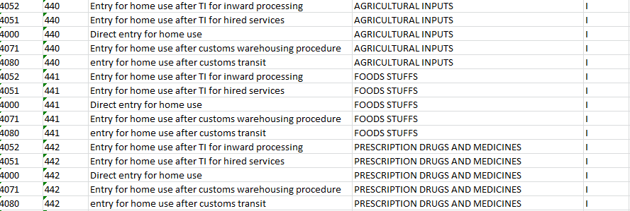
CPC can be messy
If not properly managed, CPC could grow into dozens or even hundreds codes, duplicating information about partner country, commodity classification, or others
Notes:
Just like other classifications (HS, goods, etc.), CPC must be managed properly (using information science). Otherwise, there will be a challenge in recording them (by Customs Officers or Traders). Therefore, it’s recommended that Customs Modernization also includes re organizing CPCs, taking into account the needs of statistics.
This is an example from Swaziland.

Slide 5
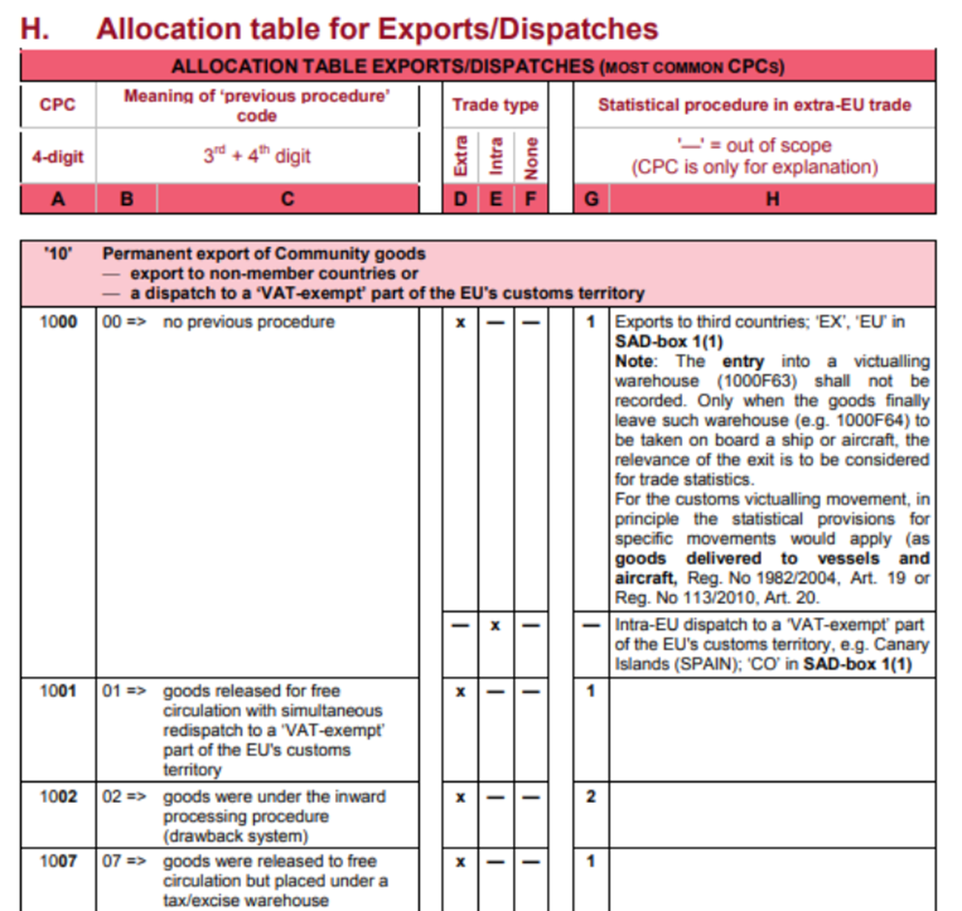
But, CPC contains wealth of data
Especially about the flow among territories (ref: presentation of movement of goods
And nature of transaction, useful for compilers of balance of payments and for measuring globalization
Also, for trade policy related statistics such as measuring the use of preferential duties after Free Trade Agreement
Notes:
Balance of payments: transaction among related parties
Economic globalization: goods for processing, re-exports

Slide 6
Attempt to Harmonize CPC at Global Level for Statistical Use
Main classification based on RKC’s Customs Procedure Codes
  “The revised Kyoto Convention (RKC) was adopted in June 1999. The provisions contained in the RKC aim at the facilitation of trade but at the same time make customs records a highly standardized and reliable data source for trade statistics across countries.” IMTS 2010 CM Para. 2.6
Memorandum Items, consists of combination of (all or part of) CPCs

Slide 7
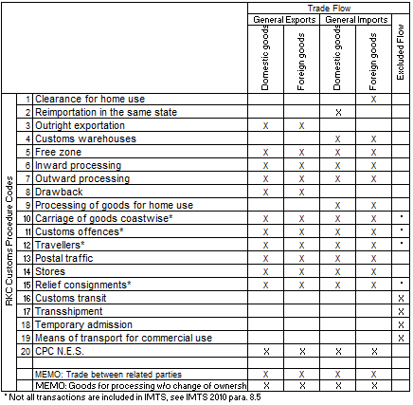
Notes:
What we need to do is now not only mapping CPC to trade flows, but also to map them into standard global CPC codes

Slide 8
Mapping National CPC to Global CPC and Trade Flow

Slide 9
Nature of transaction (NoT)
What
New data item which complements CPC
Captures purpose of the goods movement; transfer of ownership; financial compensation
Unlike CPC, NoT codes are statistical in nature
Why
The main purpose is to enable correct transition from IMTS to BoP and NA
Other analytical uses (e.g. information on FGP setup)

Slide 10
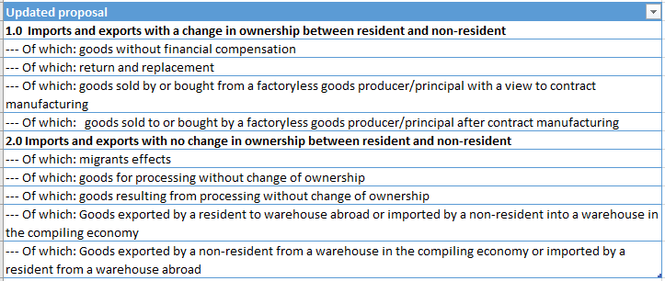
Proposed NoT output codes

Slide 11
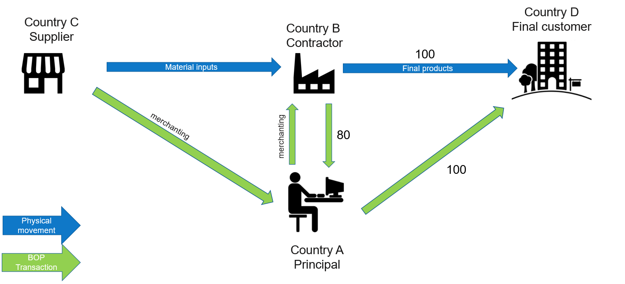
Factoryless Goods Producer (FGP)
Recording in country B:
Import from C = Of which: goods sold by or bought from a factoryless goods producer/principal with a view to contract manufacturing
Export to D = Of which: goods sold to or bought by a factoryless goods producer/principal after contract manufacturing

Slide 12
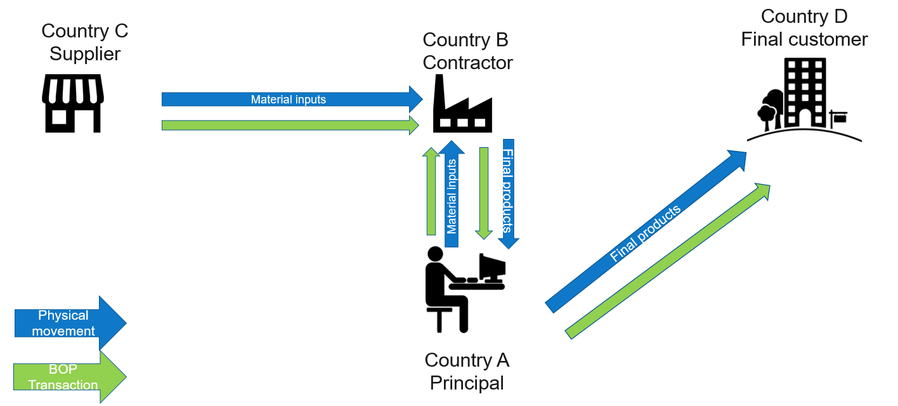
Factoryless Goods Producer (FGP)
Recording in country B:
Import from A = Of which: goods sold by or bought from a factoryless goods producer/principal with a view to contract manufacturing
Export to A = Of which: goods sold to or bought by a factoryless goods producer/principal after contract manufacturing

Slide 13
Factoryless Goods Producer (FGP)
Recording in country A:
Export to B = Of which: goods sold by or bought from a factoryless goods producer/principal with a view to contract manufacturing
Import from B = Of which: goods sold to or bought by a factoryless goods producer/principal after contract manufacturing

Slide 14
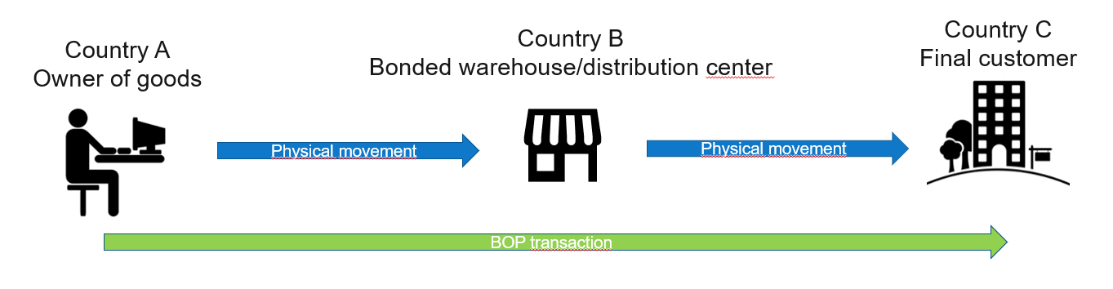
Warehousing
Proposal:
Include both bonded warehouses and distribution centers
Recording of warehouse trade on both A and B

Slide 15
Warehousing
Recording in A:
Export to B: Of which: Goods exported by a resident to warehouse abroad or imported by a non-resident into a warehouse in the compiling economy
Recording in B:
Import from A: Of which: Goods exported by a resident to warehouse abroad or imported by a non-resident into a warehouse in the compiling economy
Export to C: Of which: Goods exported by a non-resident from a warehouse in the compiling economy or imported by a resident from a warehouse abroad

Slide 16
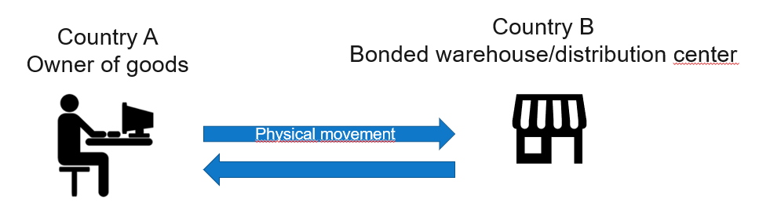
Warehousing
Recording in A:
Export to B: Of which: Goods exported by a resident to warehouse abroad or imported by a non-resident into a warehouse in the compiling economy
Import from B: Of which: Goods exported by a non-resident from a warehouse in the compiling economy or imported by a resident from a warehouse abroad
Recording in B:
Import from A: Of which: Goods exported by a resident to warehouse abroad or imported by a non-resident into a warehouse in the compiling economy
Export to A: Of which: Goods exported by a non-resident from a warehouse in the compiling economy or imported by a resident from a warehouse abroad

Slide 17
Questions
Do we need an “Other” category?
How difficult would it be to compile NoT codes?
Other questions?

